Slide 1
Connect Hearo
Ibby Welldon, Charlie Gallagher, Millie Andrews, Zak Ehsan, Amy Pinckney

Slide 2
The Problem
Pupils who have hearing problems

Slide 3
What this problem causes
The downsides of pupils having hearing problems

Slide 4
"There are approximately 45,000 children under the age of 16 who are moderately to severely deaf living in the UK"
National Deaf Children's Society

Slide 5
The solution
How our app comes into place

Slide 6
A clearer idea

Slide 7
How it works
The Processes

Slide 8
Inputs
AWS mobile hub
Microphone
Keypad

Slide 9
Work Done
Amazon Polly
Translate
Save

Slide 10
Output software
Amazon S3 (simple storage)

Slide 11
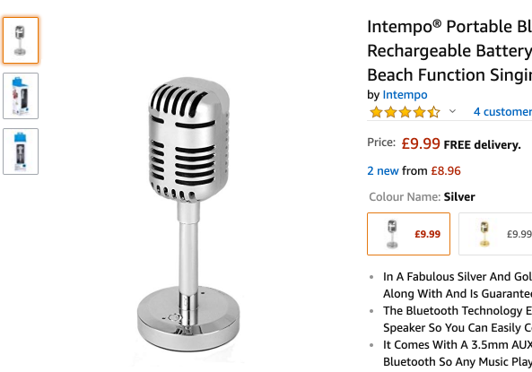
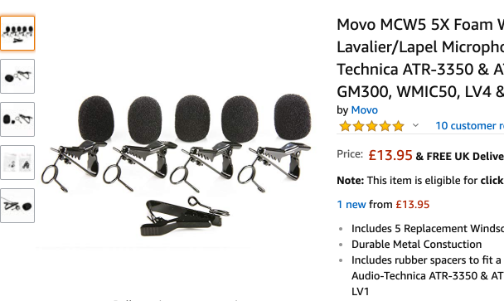
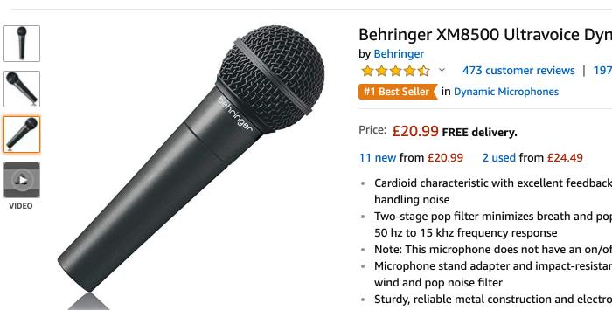
The Microphones
How does it work?

Slide 12
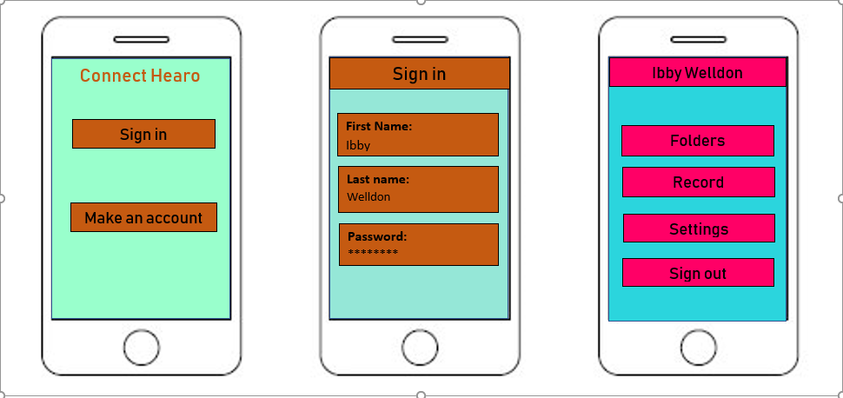
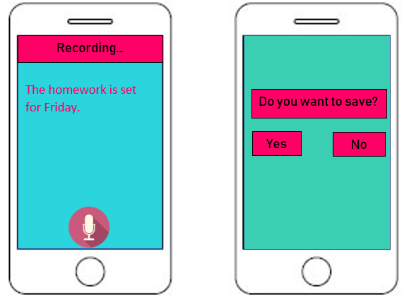
A practical demonstration

Slide 13
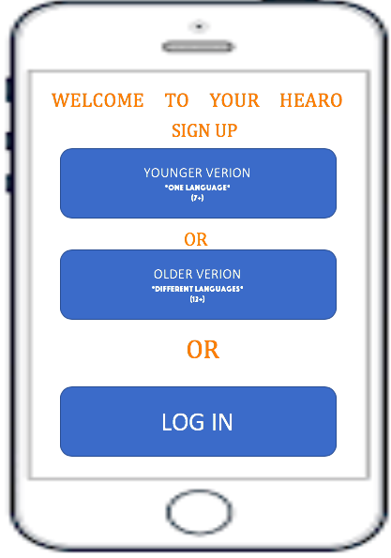

Slide 14
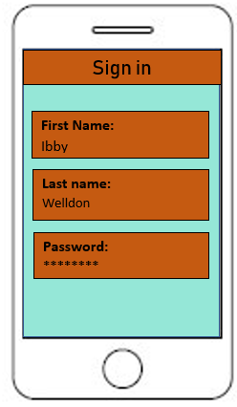

Slide 15
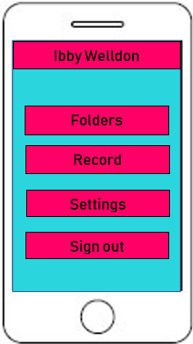

Slide 16
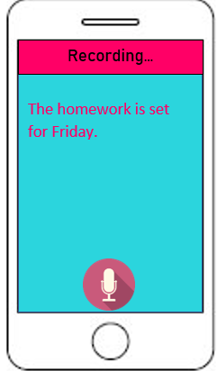

Slide 17
Further Development
Foreign students - EAL
Languages abroad
Revision help
SEN Pupils
Connecting to the pupils timetable

