Slide 1

McKinsey
Leadership Academy
10th – 11th July 2015
#leadershipacademy2015

Slide 2
What is the Leadership Academy about?
As a student, you’re facing big choices. What career should I choose? Which university? Which course? Should I take a gap year? Should I go straight into the job market?
Our Leadership Academy 2015 is a chance to have fun, meet other students from the UK and Ireland, learn about leadership and develop practical work skills. You’ll also learn about management consulting as a possible career option.
Whatever your plans, we would like to help.

Slide 3
What will you do?
100 students from England, Wales, Scotland and Ireland will be selected.
The first event is a two-day launch residential workshop on 10-11 July 2015, to be held at Wellington College in Berkshire. If you are a student based in the UK or Ireland, McKinsey will take care of your travel, accommodation and food costs.

Slide 4

Why will it be valuable?
The workshop will help you
Learn about leadership by working in small teams in a fun informal atmosphere. At the end of the workshop you’ll have a toolkit of approaches and an action plan for the coming year.
Build your career skills and get practical advice on handling tough interviews. We’ll also highlight experiences to seek out now and at university that could open doors for you in the future.

Slide 5
Who are we looking for?
We’re looking for students with an excellent track record of academic and other achievements who can demonstrate:
        Intellectual curiosity
        Personal initiative and drive
        Teamwork
        Creativity
        Impact

Slide 6

Who are we?
McKinsey & Company is a world-leading management consultancy.
We work with companies, governments and not-for-profit organisations to help them tackle their biggest challenges. Our clients are leaders in business and public life. They come to us for new ideas, global knowledge and in-depth analysis. We help them assess what they do and how they do it, so they can make lasting improvements. People who join McKinsey join a global network of leaders who will help them pursue their passions and build rewarding careers.

Slide 7

Who are we?
Future Foundations is a training organisation whose mission is to develop the social leadership and academic potential of young people.
Future Foundations believe that every young person is capable of making a positive contribution to society and taking personal responsibility for his or her own future. Our programmes are focused around leadership, social action, academic development and personal development. They all combine a mix of coaching, workshops and activities that are facilitated by inspiring coaching teams.

Slide 8

What have people said?
“An invaluable experience which although was only 2 days long, has given me a more developed skill set which I can apply to almost anything that comes my way. Thank you for such a great experience!”
Elizabeth, Leadership Academy 2012
“The most informing, action-packed and enjoyable programme that I have ever been on”
Participant, Leadership Academy 2014

Slide 9
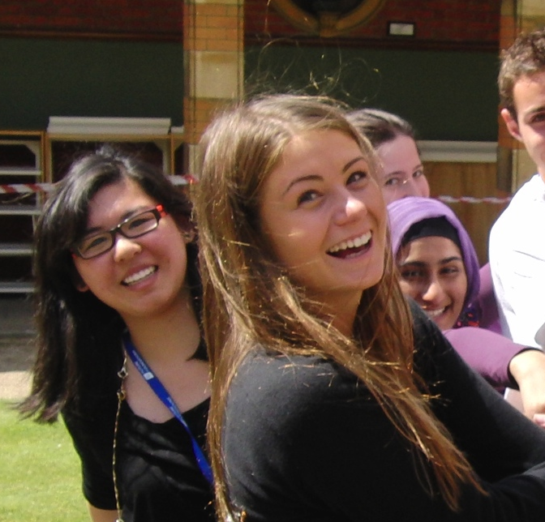
What have people said?
“I come away humbled, inspired, motivated and excited to implement the things I have learnt at the course in my life”
Participant Leadership Academy 2013
“A once in a lifetime, amazing, inspirational experience! Would not change for anything!”
Zainab, Leadership Academy 2013

Slide 10
What do I need to do?
If you think you have the qualities we are looking for and would like to apply, you need to:
      Secure the support of a current teacher or tutor who is willing to provide a reference for you.
      Fill in an application form, which can be downloaded on the McKinsey Website. Tell us about you, your goals and your leadership experiences to date.
      Compile an up-to-date CV and submit it with your application form following the guidelines on the McKinsey Website to ensure you include the information we need.
The closing date for applications is Wednesday 8 April 2015.

Slide 11
Be a leader in life
McKinsey Leadership Academy 2015
#leadershipacademy2015
www.mckinsey-leaders.co.uk

